Slide 1


Slide 2

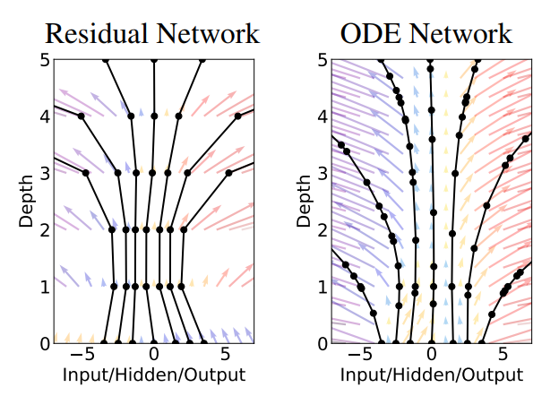
Neural Ordinary Differential Equations

Slide 3
Neural Ordinary Differential Equations
Best paper award at NeurIPS 2018

Slide 4

Content
Motivation for using differential equations
Simple implementation of black-box solver (in python)
Integrating NN with solvers
Computing gradients through ODE - adjoint method
Results and potential applications
Appendix: Continuous Normalizing Flows

Slide 5
Solving dynamical systems with ODEs

Slide 6
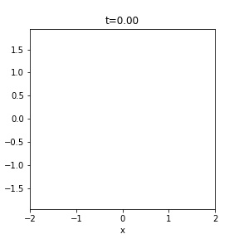
Motivations for description of dynamical systems
Time evolution of states in some unknown system
Assuming full knowledge about the problem
clue: a problem of three bodies connected with springs
How many parameters (at most) we have to know to fully describe this problem and be able to infer future states ?
3 bodies
* 2 (initial position)
* 2 (initial velocity)
+ 3 (spring strength)
+ 3 (spring equilibrium distance)

Slide 7
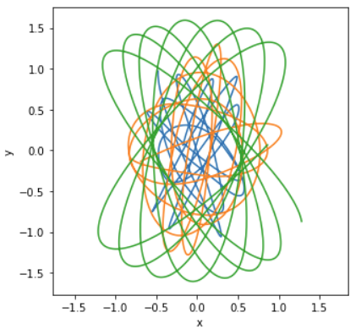

Motivations for description of dynamical systems
States evolution in some unknown system
Now, try to solve this problem with regular Neural Network ...

Slide 8
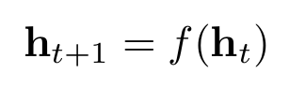
Hidden state transformation in NNs
In regular neural networks (NNs) states are transformed by series of discrete transformations
where f is e.g. some Dense or Convolutional layer
t (a layer index) can be interpreted as time index, such that we transform some input data at t=0 to the output space at t=N
in order to learn some dynamical system (e.g. physical system) with RNNs we must discretize time steps
there are problems where expressing time as a continuous variable is more natural e.g. physical simulations, events which happen at irregular intervals
so it may be profitable to express our problem as a differential equation

Slide 9
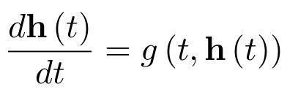
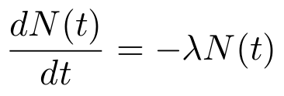
ODE and initial value problem
We are interested in problems described by following ordinary differential equation (ODE):
with some known initial value for h: h(t=0) = h₀
this kind of equation can describe plenty of dynamical (e.g. physical) systems
For example: radioactive decay (with N being number of atoms/mass of radioactive material):

Slide 10
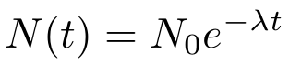
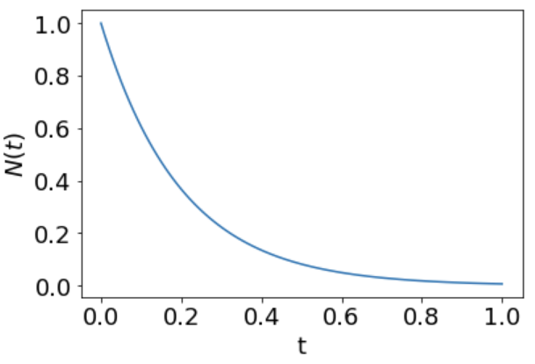
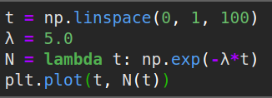
ODE case study: Radioactive decay - differential form
For example: radioactive decay (with N being number of atoms/mass of radioactive material):
Analytical solution:

Slide 11
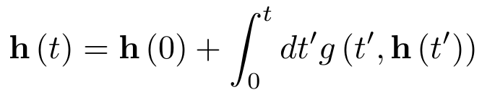
ODE case study: Radioactive decay - integral form
Any differential equation of form can be expressed in terms of integral

Slide 12
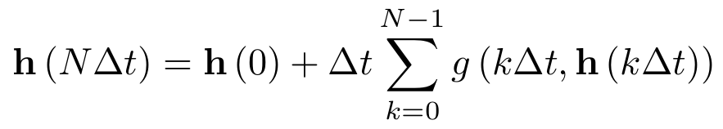
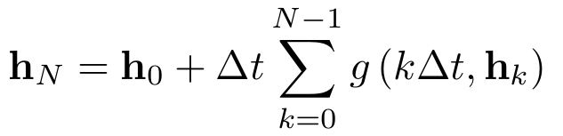
ODE case study: Radioactive decay - numerical integration
Integral form of ODE:
solution at time t depends
on all values at t’ < t
We are going to use methods which will approximate the integral
The simplest approximation replaces integral with simple sum taking time at discrete time steps:
Using shorter notation we get:

Slide 13
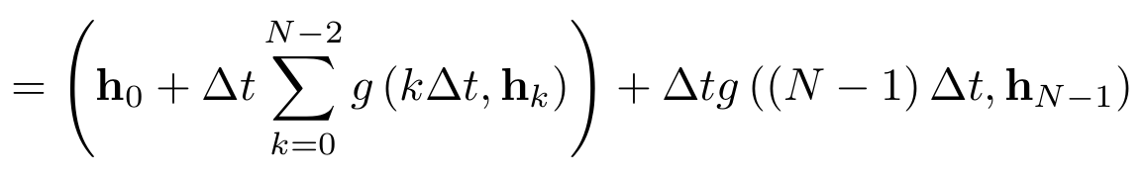
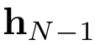
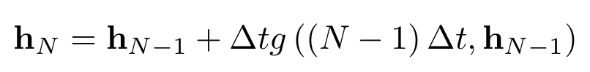
ODE case study: Radioactive decay - numerical integration
Using shorter notation we get:
From which we obtain following recurrence formula:
Euler’s method for solving differential equations.
Same result can be obtained by approximating derivative in the original ODE problem

Slide 14
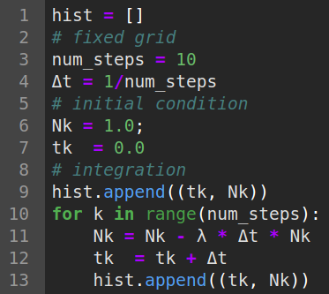
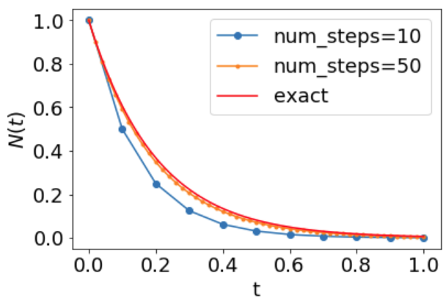
ODE case study: Radioactive decay - numerical integration
Euler method is the simplest method known:

Slide 15
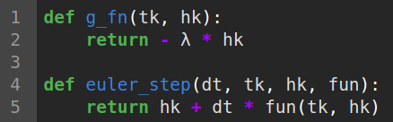
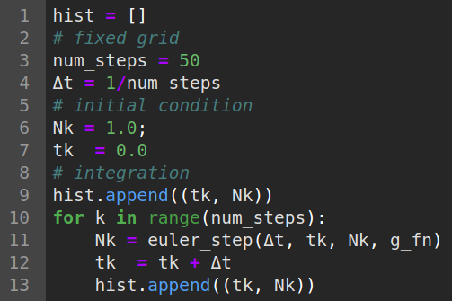
ODE case study: Towards black box solvers
Lets refactor this code a bit and create more general solver:
integration of time variable

Slide 16
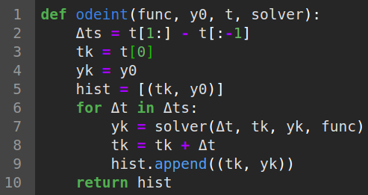
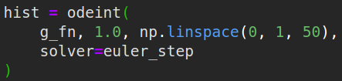
ODE case study: Towards black box solvers
Implementation of more general solver
Here we assume fixed grid approach, adaptive methods are possible
We would like to have:
problem function, can be easily changed
example solver, can be easily changed
A general fixed grid solver in 10 lines

Slide 17
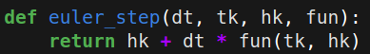
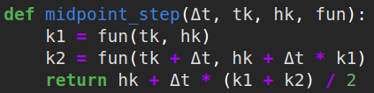
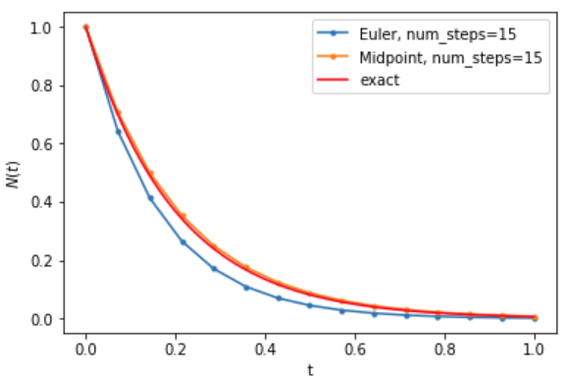
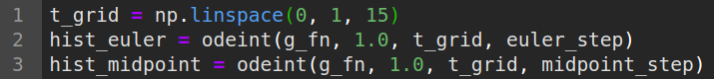
ODE case study: Towards black box solvers
Implementing better solvers we can achieve better accuracy with less steps
Euler method (explicit version)
Midpoint method (or RK2) - 2nd order method
Euler vs Midpoint
Midpoint has lower error (obviously) =>

Slide 18
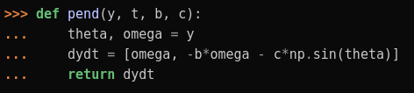
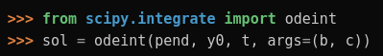
ODE case study: Towards black box solvers
odeint is a general purpose ODE solver, one must provide fun(t, h_{t}), initial conditions, timesteps at which function will be evaluated and solver
there are plenty of ready to use black box solvers:
fixed grid or adaptive methods
implicit or explicit methods
...
higher order methods like Runge–Kutta (RK4) or Adams–Bashforth guarantee better numerical accuracy
all of them can be implemented in a common interface of form (e.g. scipy):
tf.contrib.integrate.odeint <- another example

Slide 19
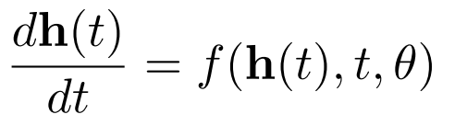
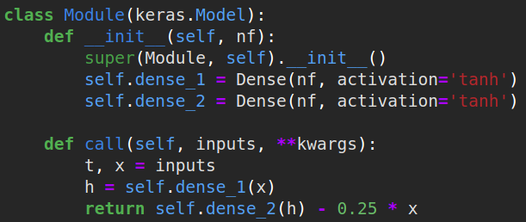
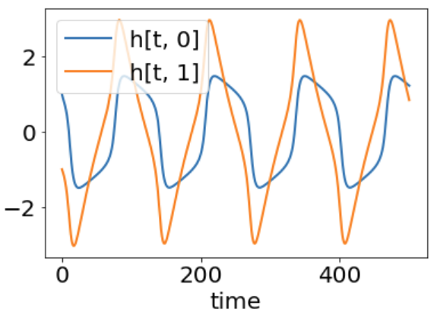
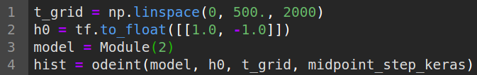
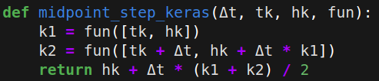
Integrating Neural Networks with ODE solver
odeint can be used to integrate response of some Neural Network
Define some model with __call__ function
Integrate (small change in the solver definition)
Plot history:

Slide 20
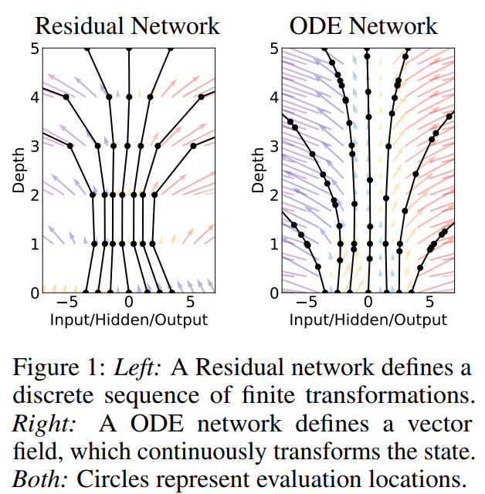
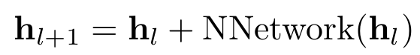
Integrating Neural Networks - ResNet analogy
Euler method is the simplest one:
Some people find this equation similar to ResNet skip connection
l - enumerates layers
However, each step in ResNet has its own parameters, here are reusable!
Nevertheless a possible connection between NeuralODEs and skip connections in an interesting question

Slide 21
Integrating Neural Networks - black box solvers
We can use existing (and efficient) implementation of solvers to integrate NNs dynamics
The memory cost is O(1), due to reversibility i.e. we don’t need to store all activations in the graph, we can easily recover them by backward integration (i.e. time reversed integration)
Complex dynamics can be modeled with fewer parameters
We can control accuracy/speed trade-off with adaptive solvers by setting lower/higher error tolerances
Hidden states can be accessed at any value of t - no discrete time steps as in RestNet skip connection

Slide 22
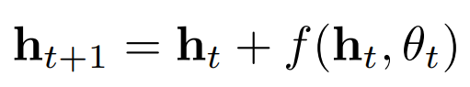
NeuralODE - forward mode integration summary
So far we have discussed:
New type of NNs where ResNet-like skip connection
is replaced by ODE (a new type of NN)
ODE is then solved with black box solver accessed e.g. via odeint function
Output state is then used to compute some loss:
This loss is then used to compute gradients, but how to do it?

Slide 23
Backpropagating through NeuralODEs - a naive approach

Slide 24
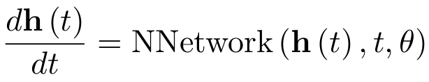
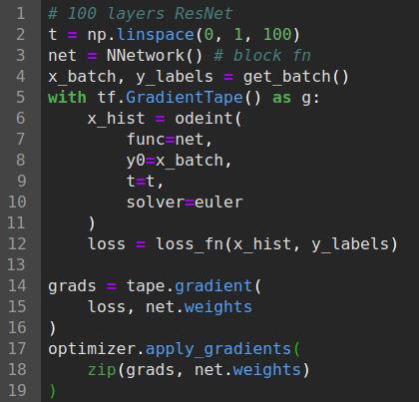
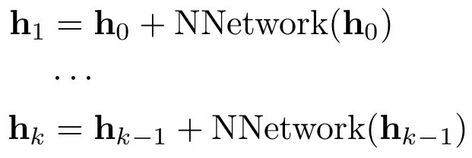
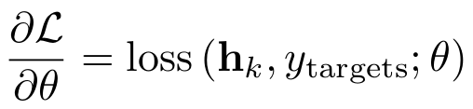
NeuralODE - naive backpropagation
When using Euler method to solve ODE
solver update step can be written as ResNet skip connection block
after k-steps we get just regular ResNet architecture build from k blocks
gradient of loss can be easily computed with existing methods

Slide 25
NeuralODE - naive backpropagation
When naive backpropagation fails ?
Many higher order solvers are also differentiable
For example Midpoint (RK2), RK4 updates are easily differentiable
for example we want to integrate dynamical systems through 1M timesteps, this would correspond to roughly 1M layer NN, so we will end up with memory issues,
memory issues arise because we need to store all activations in the graph and higher order solvers even more activations,
backpropagation through adaptive solvers maybe infeasible due to numerical errors, instability or just non-differentiability of the solver

Slide 26
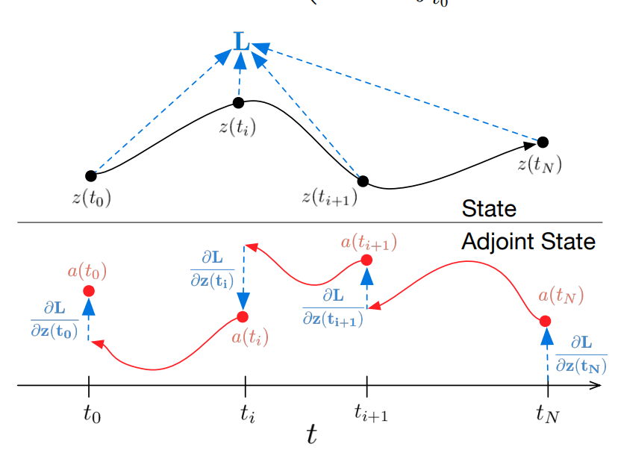
Backpropagating through NeuralODEs - adjoint method

Slide 27
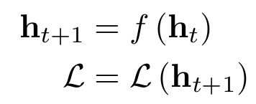
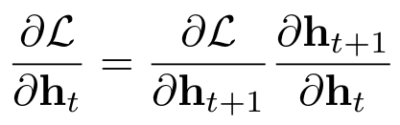
NeuralODE - adjoint method
Adjoint method has been developed to overcome mentioned problems
Adjoint sensitivity method has long history: (Pontryagin et al., 1962!)
Adjoint method can be understand as a continuous version of chain rule
Chain rule: Consider following sequence of operations (L is a scalar loss):
We can compute gradient of L w.r.t input state using chain rule
This formula is a core of any Deep Learning autograd implementation

Slide 28
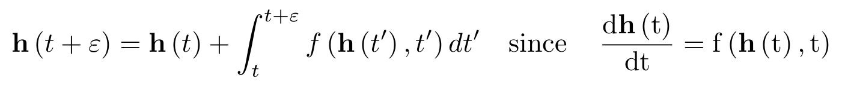
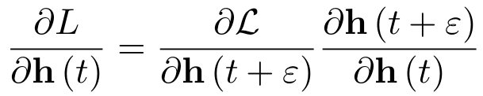
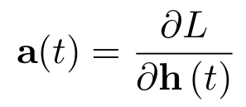
NeuralODE - adjoint method (derivation)
Consider following sequence of operations (L is a scalar loss)
We can compute gradient of L w.r.t input state using chain rule
We are interested in infinitesimal (continuous) change in hidden state:
Same chain rule can be applied
Adjoint state is defined as:

Slide 29
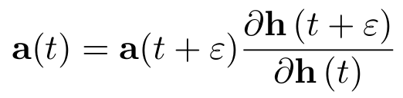
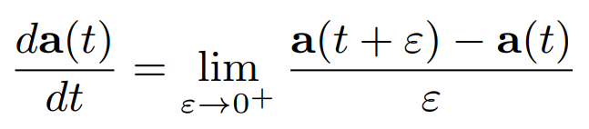
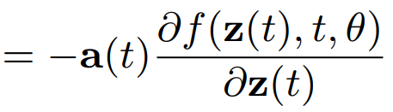
NeuralODE - adjoint method
An infinitesimal change in the hidden state (1)
Continuous chain rule can be applied (2):
Adjoint state is defined as (3):
From Eq.(2) and Eq.(3) we get (4):
By combining all equations above we can derive differential equation which describes dynamics of adjoint state:
should be h instead of z
full proof in paper

Slide 30
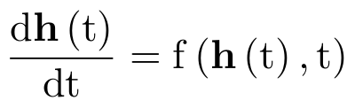
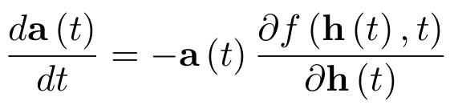


NeuralODE - adjoint method
Final formulas:
forward dynamics
adjoint state (definition)
adjoint state dynamics
discussed later
Why adjoint state is important and useful ?
When doing backpropagation we need to compute these two quantities
The first one is actually an adjoint state at a(t=0)
We know adjoint state at a(t=t_{end}) since this is just a gradient of loss w.r.t. final hidden state
We can use adjoint state dynamics equation and integrate it to find a(t=0)
This can be done using exactly the same solver applied to forward dynamics

Slide 31



NeuralODE - adjoint method - example usage
Let as consider following toy problem:
We want to find such h(t=0) that h(t=25)=(0, 1/2), with dt=1/200
Select some initial conditions e.g. h(t=0)=(1, 0)
Integrate ODE: h_hist = odeint(func, h0, time_steps)
target final state
initial quess state
Implementation can be found in: 1A.Adjoint_method.ipynb

Slide 32



NeuralODE - adjoint method - example
Define cost function
Compute initial value for adjoint state (gradient of loss w.r.t last state):
Solve adjoint state dynamics ODE by integrating backward in time i.e. from t=25 to t=0
a(t=0) is a gradient of dL/h(t=0) which we can apply to reduce the loss

Slide 33




NeuralODE - adjoint method - example
update initial state with gradient direction
Repeat steps the process until converge ...
number of gradient descent updates
final state
initial optimized state
Note: this problem can be solved by easily by inverting time in original problem and start problem from the final state :)

Slide 34

NeuralODE - adjoint method - example #2 (bullet problem)
bullet initial velocity problem: given a target position x_{t} - estimate initial conditions for bullet velocity such that it will hit the target
this problem cannot be easily solved by simply inverting dynamics since we don’t know final velocity
bullet trajectory for sample initial condition
Assumptions: cannon is fixed at position x=0 and we can change velocity vector v₀ its angle and magnitude (two parameters)

Slide 35

NeuralODE - adjoint method - another example
the way we solve this problem is exactly the same
we have to define cost and compute gradients w.r.t initial velocity i.e. the value of adjoint state a(t=0)
Implementation can be found in: 2.Demo_optimize_bullet_trajectory.ipynb

Slide 36


NeuralODE - computing gradients w.r.t model parameters
From last few slides we get set of formulas:
forward dynamics - some Neural Network
adjoint state - a definition
adjoint state dynamics - proved
How to compute gradients w.r.t model parameters ?
It is easy to show that the adjoint equation for weights is (for an explanation check paper):

Slide 37

NeuralODE - final algorithm
The final algorithm for the reverse mode computation (copied from paper):
note that input/output of aug_dynamics fn can be expressed in terms of single vector which is expected by many ODE solvers implementations
ODESolve is same as odeint function in previous slides
whole implementation can fit ~100 lines of python code

Slide 38





NeuralODE - example usage of my implementation in TF
The spiral problem (authors example)
generate target trajectory
2. Model Neural Network
3. Use stochastic gradient descent to optimize target on: model = ODEModel()

Slide 39





NeuralODE - spiral: results
Initial trajectory
after few iterations
converged trajectory
We can do some extrapolation

Slide 40

NeuralODE - MNIST experiment from paper
Classification problem on MNIST dataset
Less parameters while reaching similar accuracy

Slide 41

NeuralODE - MNIST experiment from paper
Classification problem on MNIST dataset: properties of the adaptive solver

Slide 42



NeuralODE - A generative latent function time-series model
We can train a generative model which will produce continuous latent vectors

Slide 43


NeuralODE - Tensorflow implementation of reverse mode
Implementation of the reverse mode requires Jacobian-vector products
Many frameworks do not support direct Jacobian computation or it’s inefficient, so we cannot easily compute df/dz and df/dTheta matrices above
However, we can efficiently compute Jacobian vector products (JVPs) by providing output_gradients to gradient function, consider: y = L(W*x)=L(h)
General reverse mode can be implemented in ~10 lines of code

Slide 44
Advanced part: Continuous Normalizing Flows

Slide 45

NeuralODE - Continuous Normalizing Flows (CNFs)
Normalizing Flows (NFs) provide set of tools for computing probability distribution of transformed stochastic variable
For more details see on NFs my previous presentations

Slide 46


NeuralODE - Continuous Normalizing Flows (CNFs)
Transformations in regular NFs:
CNFs analog (note f and g will be different functions):
proof in paper
Computing trace is more efficient than computing determinant O(N³)
However computing jacobian is not efficient, we can approximate trace by sampling, see FFJORD: Free-form Continuous Dynamics for Scalable Reversible Generative Models

Slide 47



NeuralODE - CNFs implementation
More detail on my Github repo
We can still use the same API as in case of NeuralODE
t, z_p_concat = inputs
hyper_net(t) returns NFs parameters in function of time
compute f(z(t), t)
compute jacobian
concat dz/dt with dlogpz to have one vector: ode solver accepts single vector

Slide 48

NeuralODE - CNFs results
CNFs are naturally trained with Maximum Likelihood Method

Slide 49

NeuralODE - CNFs results
CNFs are invertible hence we can sample from them like in NFs
Density evolution at different time snapshots
Bottom rows show NFs results

Slide 50



NeuralODE - CNFs my experiments
Transforming two moons into unit gaussian in few lines
Z transformations to unit gaussian during training:

Slide 51



NeuralODE - CNFs my experiments
Sampling from trained model (more detail in my notebooks)
t=1 corresponds to initial state: we start from unit gaussian
t=0 should generate moon distribution
(right->) continuous transformation of density function
More animations here: youtube

Slide 52
Solving dynamical systems with ODEs - summary

Slide 53

NeuralODE - summary
NeuralODEs are new type of Neural Networks,
They are defined in terms of dynamical ODE
The number of layers can be related with number of ODE solver steps
Adaptive solvers allow to reduce number of steps at cost of lower precision, but higher speed
So far NeuralODEs are slower than regular NNs of the same depth
NeuralODEs are invertible and can be used to sample trajectories

Slide 54
References
Replacing Neural Networks with Black-Box ODE Solvers - slides from presentation
Reddit discussion on TF implementation
Understanding Neural ODE's - blog post on Neural ODEs
Neural Ordinary Differential Equations and Adversarial Attacks - blog post with some tests with Adversarial attacks on NeuralODEs
FFJORD: Free-form Continuous Dynamics for Scalable Reversible Generative Models - a follow up paper of the authors which focus mainly on CNFs, has nice trick how to approximate jacobian trace via sampling
Notes on Adjoint Methods for 18.335 - as in title notes on adjoint method
Neural Ordinary Differential Equations - reference paper

Slide 55


Thank you!

Slide 56



NeuralODE - Continuous Normalizing Flows (CNFs)
We can apply the same approach as in case of regular NNs and consider continuous transformation of variables
In case of planar flows we have:
A continuous analog of it:
Note: In CNFs f(z, t) can be non-bijective
What is the dynamics of probability distribution ?

